Slide 1
Automated Study Assistant Josie Li Weekly Report July 30th -
Josie Li (jl9gf) UVA Class of 2020

Slide 2
Milestone 1 Goal:
Write the Progress Page for the website purely with HTML/CSS
Create the database in Google Cloud and put dummy data

Slide 3
Week of July 30th – August 3rd
Goal:
Finish learning HTML/CSS/JS and d3.js
Create the progress page purely with HTML and CSS

Slide 4
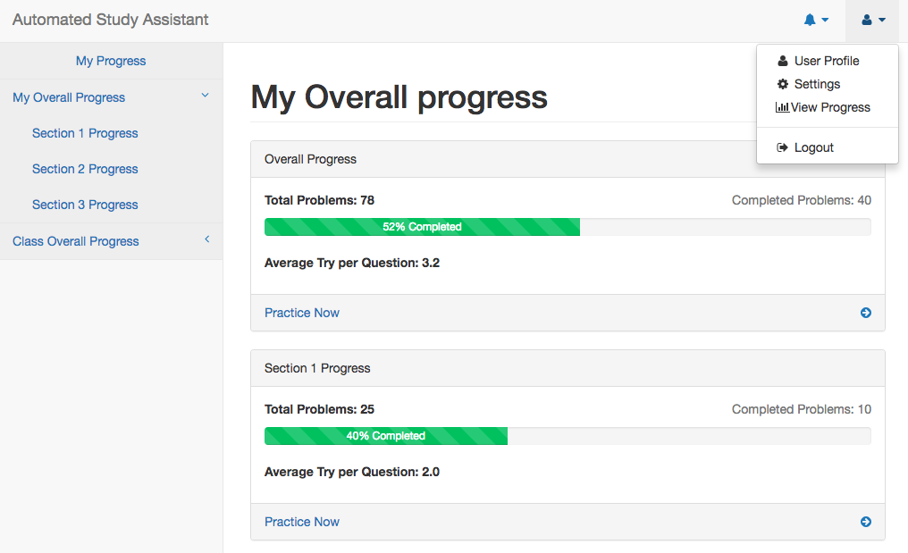
Progress page with HTML/CSS:
I used Bootstrap and SB Admin 2 (an open source dashboard template for Bootstrap) to create the progress page with hard-coded data.
Input Request: User get into progress page by clicking on the user icon on the top right and click ”view progress”
The navigation menu bar is on the left of the page where students can see individual progress and class progress

Slide 5
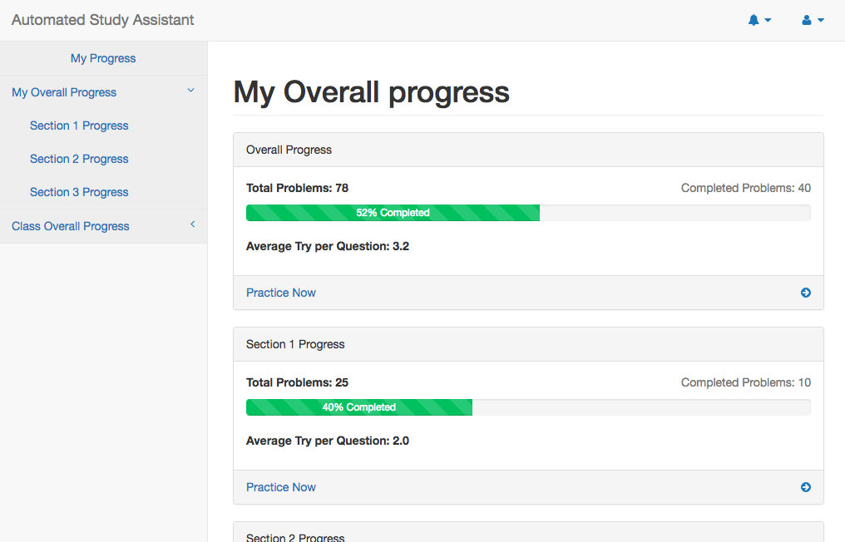
Progress page with HTML/CSS:
Progress Metrics shown:
Total number of problems & number of Problems completed
Bar view of the percentage of problems finished
Average number of tries per question
”Practice Now” lead to practice page

Slide 6
Week of August 6th - August 10th
Goal:
Build the database in Google Cloud and store dummy data

